Slide 1


Subreddit classification through NLP
Done by: Edmund Ho

Slide 2
Content
Problem Statement
Data collection & cleaning
Pre-processing & EDA
Model Selection
Features importance
Recommendation & Conclusion

Slide 3

Problem statement
Financial advice and discussions are rife on the internet nowadays and available to almost everyone.
It is important to create a classifier to distinguish between sound investment advice and “degen” highly speculative trading strategies
r/wallstreetbets
r/stocks
Fast “tendies”
Active trading, driven by hype
Long term investment
Driven by fundamentals

Slide 4
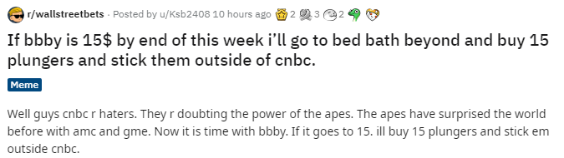
Data collection & cleaning
Data collection | Data cleaning
Before cleaning: 2000 posts from r/wallstreetbets 2000 posts from r/stocks | Combined title and selftext
 | Removal of duplicates
After cleaning: 50.4% posts from r/wallstreetbets 49.6% posts from r/stocks | Removal of special characters, hyperlinks and emojis
Title
Selftext

Slide 5
Pre-processing & EDA
Stop words | Common words are identified from Venn diagram and added into stop words corpus
Tokenize | Split phrase, sentences to individual words
Lemmatization | Group similar terms to be analysed as single item
Porter Stemming | Remove prefixes and suffixes of word
Count Vectorizer | Convert a collection of text documents to a matrix of token counts
TF-IDF Vectorizer | Consider overall document weightage of a word.

Slide 6
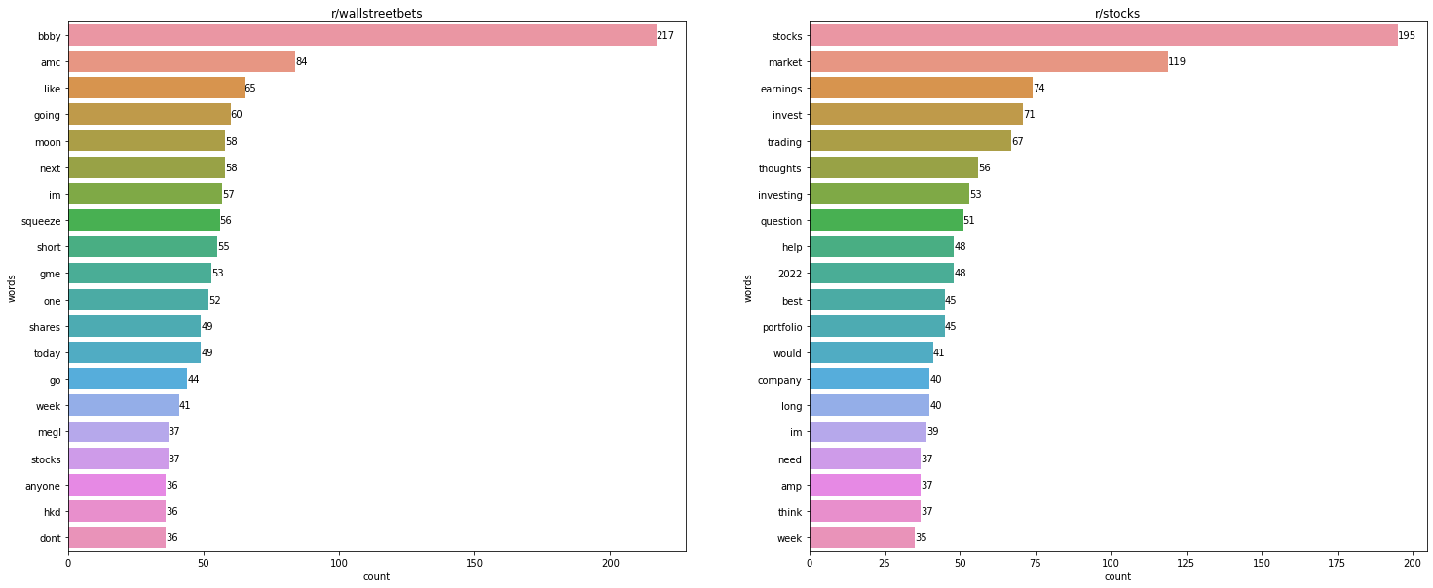
Pre-processing & EDA
Most common 20 words in title

Slide 7
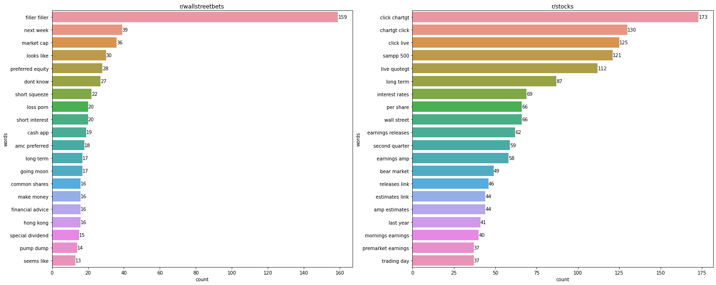
Pre-processing & EDA
Most common 20 bigrams in title

Slide 8
Modelling methodology
Pipeline + Grid Search
Classifier | Random Forest | Naïve Bayes
Vectorizer | Count Vectorizer | TF-IDF Vectorizer
Word processing | Unmodified | Lemmatizing | Stemming

Slide 9
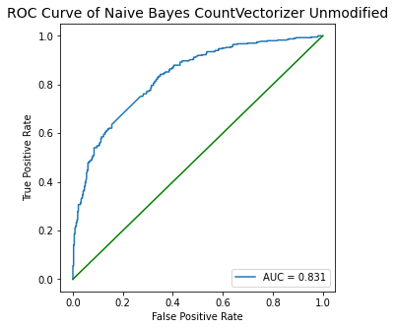
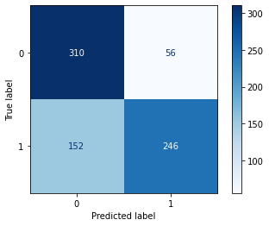
Final model parameters
Classifier | Multinomial Naïve Bayes
Vectorizer | TF-IDF
Word processing | Unmodified text
Alpha | 1
Max features | 500
Minimum document frequency | 2%
Maximum document frequency | 85%
Ngram range | (1,2)

Slide 10

Model selection
Classifier | Vectorizer | Word processing | Train accuracy | Test accuracy | Generalisation (%) | Accuracy | AUC Score
Random Forest | Count vectorizer | Unmodified | 0.731 | 0.69 | 5.609 | 0.69 | 0.686
 |  | Lemmatized | 0.713 | 0.683 | 4.208 | 0.683 | 0.682
 |  | Stemmed | 0.72 | 0.688 | 4.444 | 0.688 | 0.684
 | TF-IDF | Unmodified | 0.745 | 0.688 | 7.651 | 0.688 | 0.683
 |  | Lemmatized | 0.747 | 0.691 | 7.497 | 0.691 | 0.689
 |  | Stemmed | 0.755 | 0.695 | 7.947 | 0.695 | 0.691
Naïve Bayes | Count vectorizer | Unmodified | 0.702 | 0.709 | -0.997 | 0.709 | 0.71
 |  | Lemmatized | 0.693 | 0.692 | 0.144 | 0.692 | 0.692
 |  | Stemmed | 0.702 | 0.703 | -0.142 | 0.703 | 0.702
 | TF-IDF | Unmodified | 0.751 | 0.728 | 3.063 | 0.728 | 0.733
 |  | Lemmatized | 0.745 | 0.713 | 4.295 | 0.713 | 0.718
 |  | Stemmed | 0.758 | 0.712 | 6.069 | 0.712 | 0.71

Slide 11
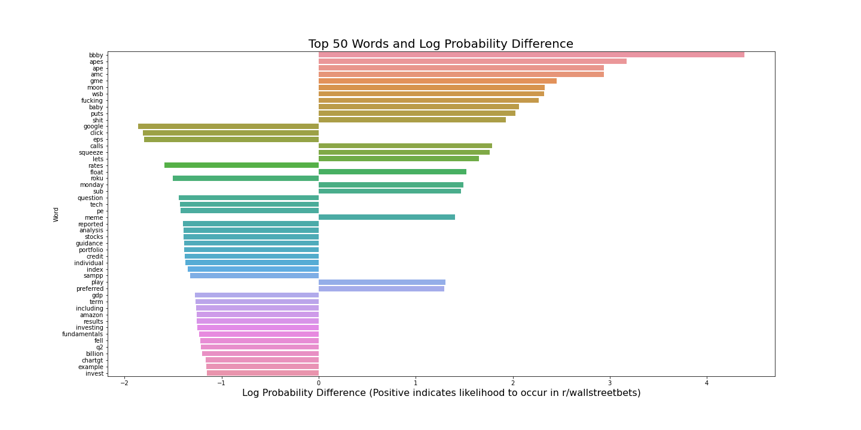
Features importance
For r/wsb, the features centres around meme stock tickers
(bbby, amc, gme) or options trading (calls, puts, squeeze)
Conversely, for r/stocks, the features are related to long term investing (index, investing, s&p) and company fundamentals (eps, guidance, pe)

Slide 12
Recommendation & Conclusion
Titles
Popular post
Sentimental analysis
Stopwords
Title can be weighted more than self text
Due to high frequency posting, scrape popular posts instead of new posts
Positive and negative sentiments of post
Develop list of ticker and stop words to add to the stopwords corpus
The Naïve Bayes Model with TF-IDF Vectorizer on Unmodified text will be the final model selected for the subreddit classifier.
It is the best performing among the models with its accuracy, precision and AUC score.
More hyperparameter tuning and classifiers can be explored to further increase the accuracy of the classifier

Slide 13

Q&A Session time

